Slide 1
El Cleano Vino
Ethan Call- Chemical Engineering
Garrett Tinus- Ocean Engineering
Megan McConnell- Biochemistry

Slide 2
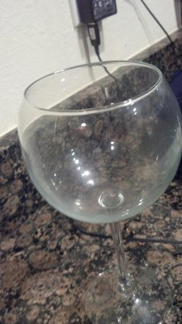
What’s the problem?
Problem Statement
Based on a United Kingdom survey posed by Miele Professional in 2014, 52% of customers out of 2,000 stated that dirty glassware was their top "restaurant turnoff."

Slide 3
Survey

Slide 4
survey

Slide 5
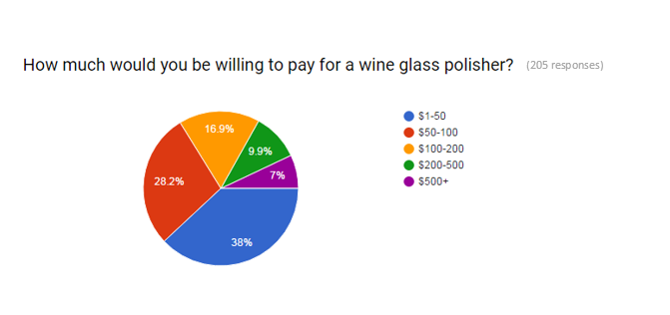
Survey

Slide 6
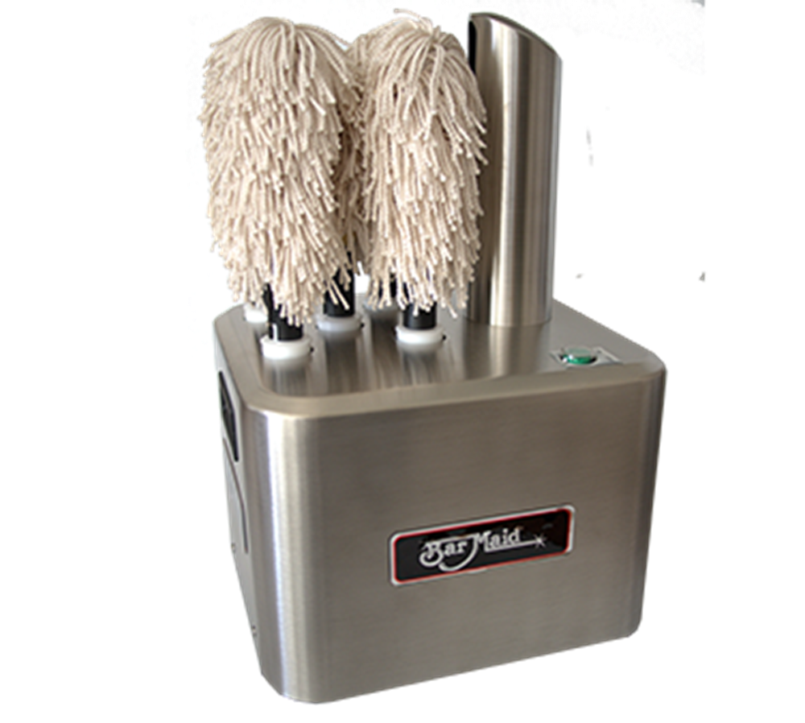
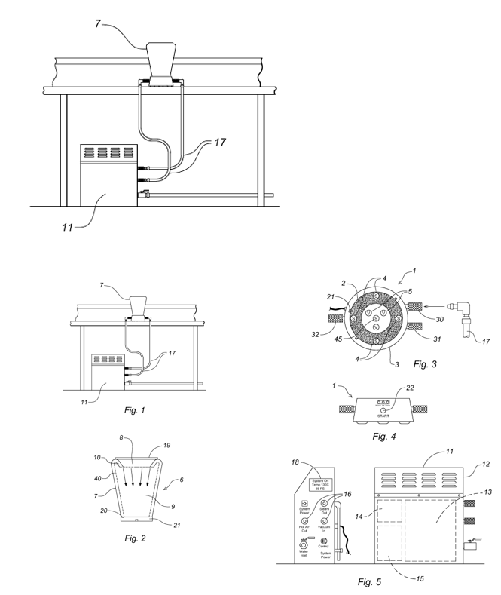
Existing Solutions
Bar Maid- $1,134

Slide 7
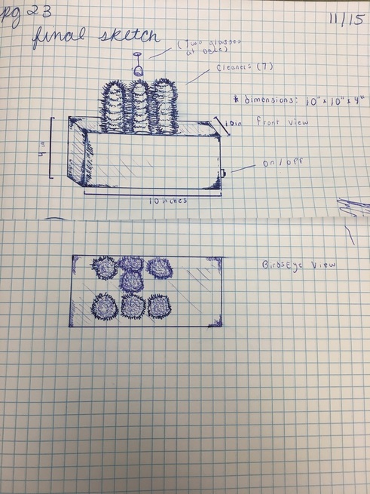
Sketch

Slide 8
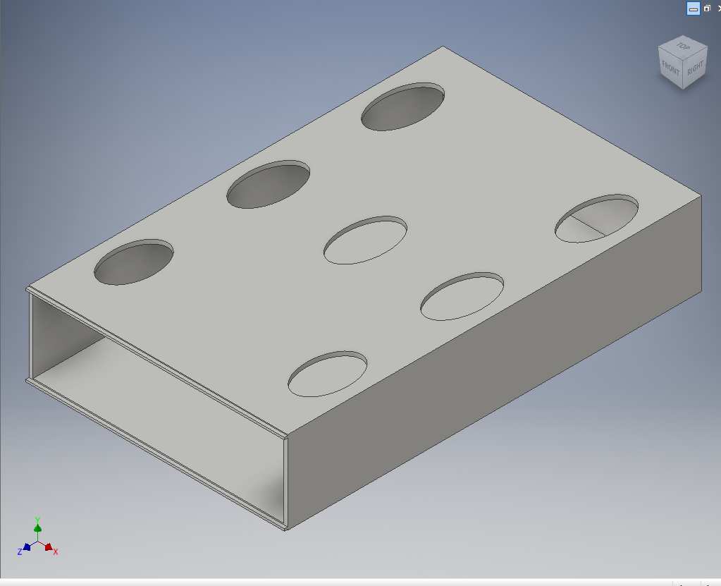
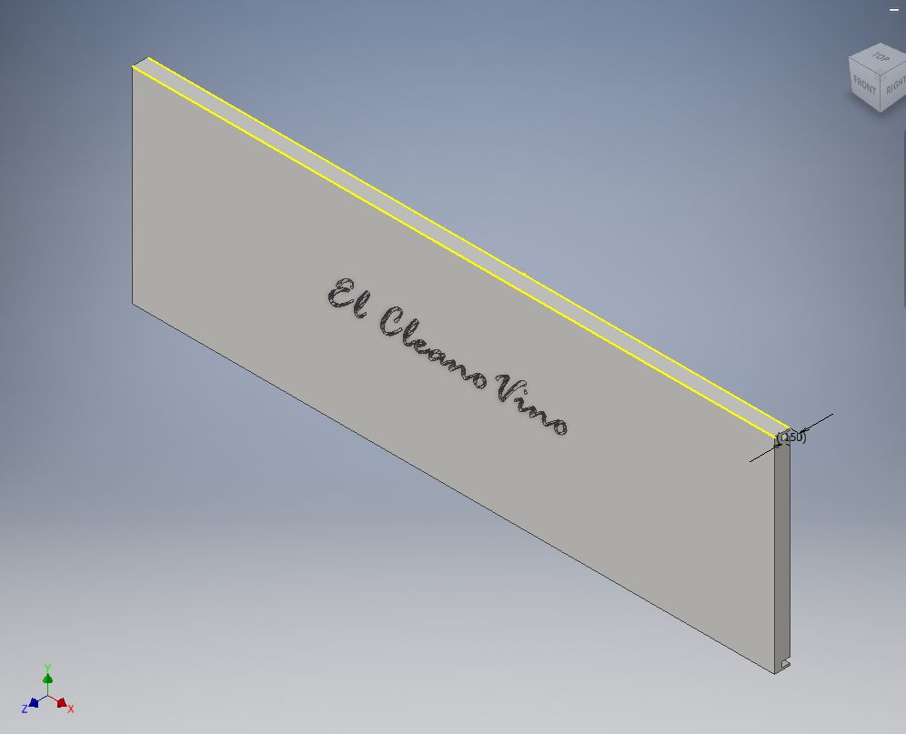
Constructing a Prototype

Slide 9
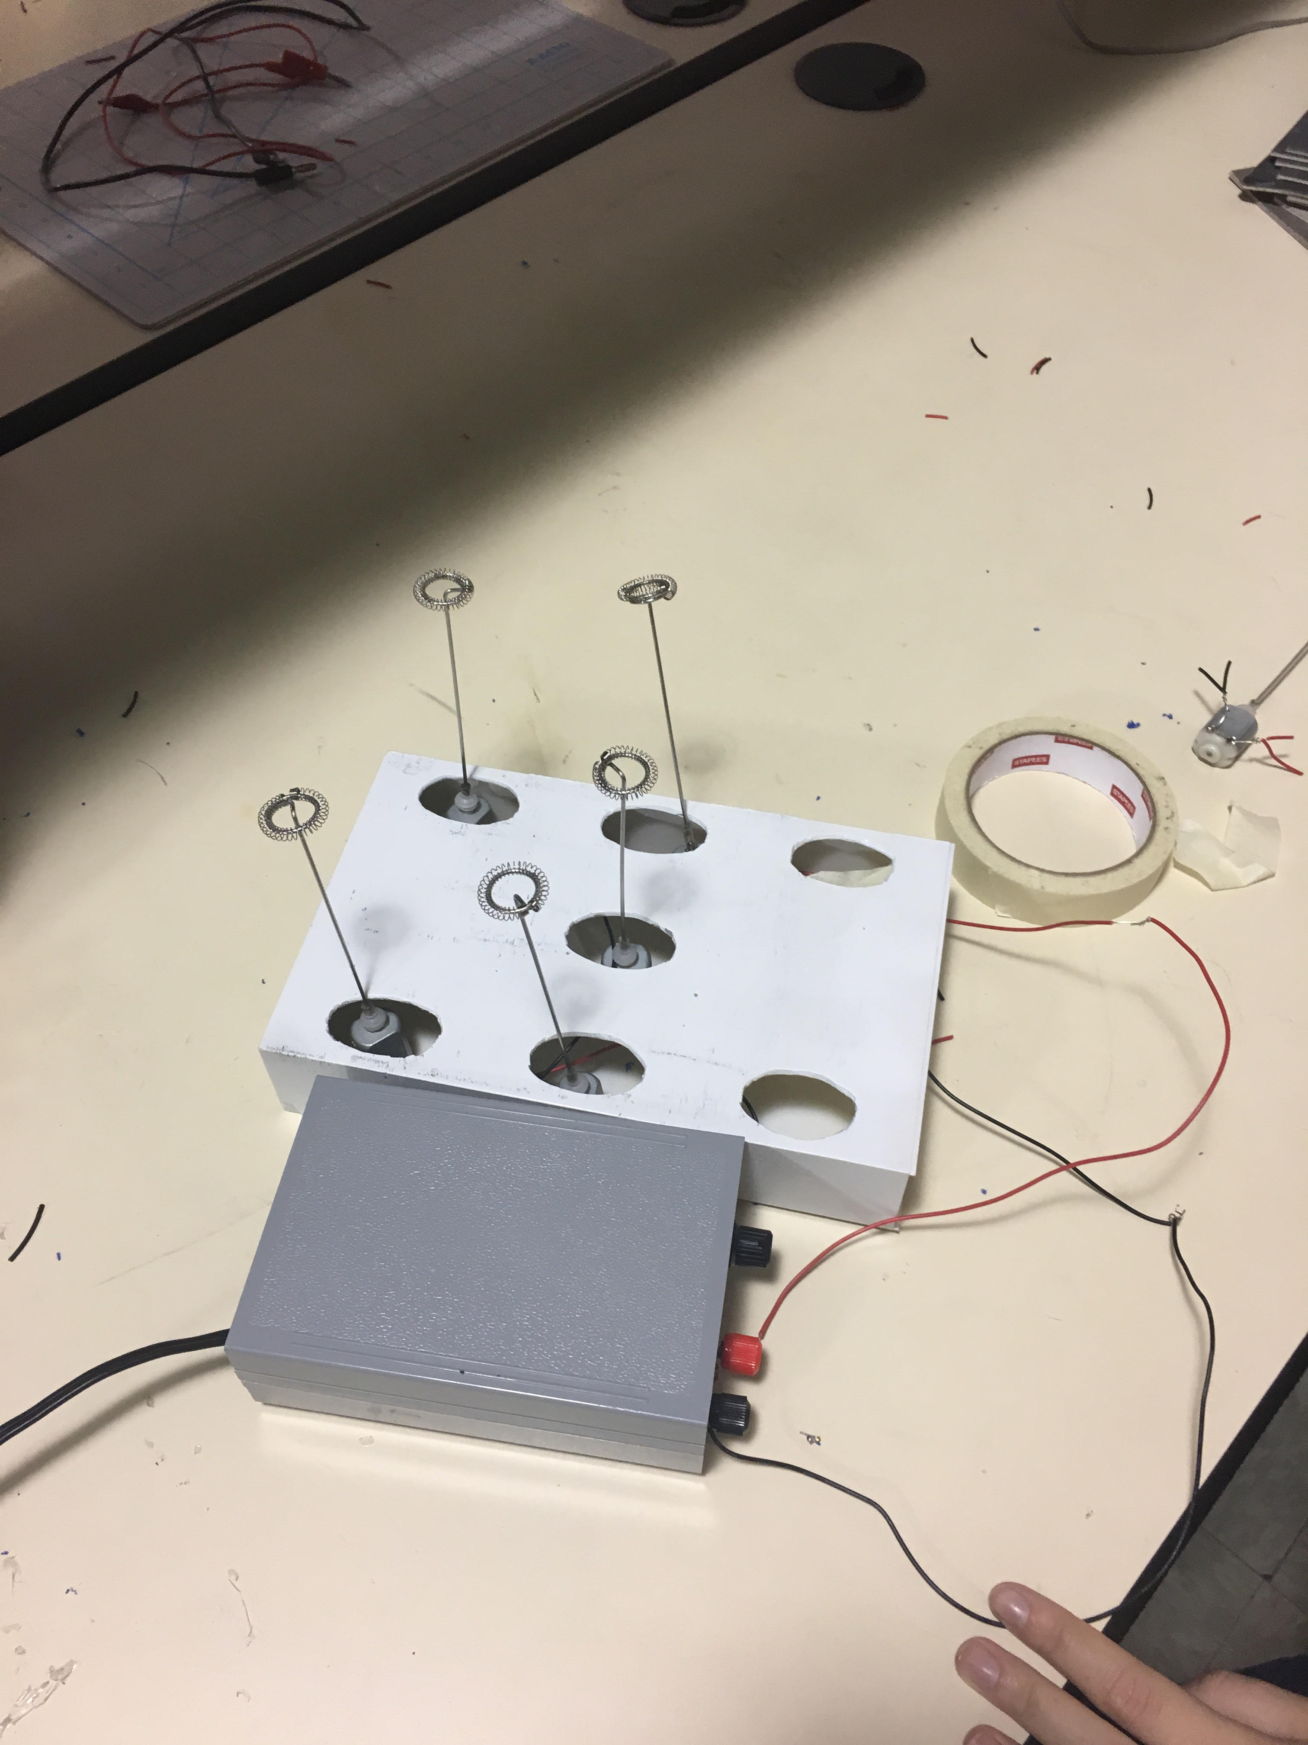
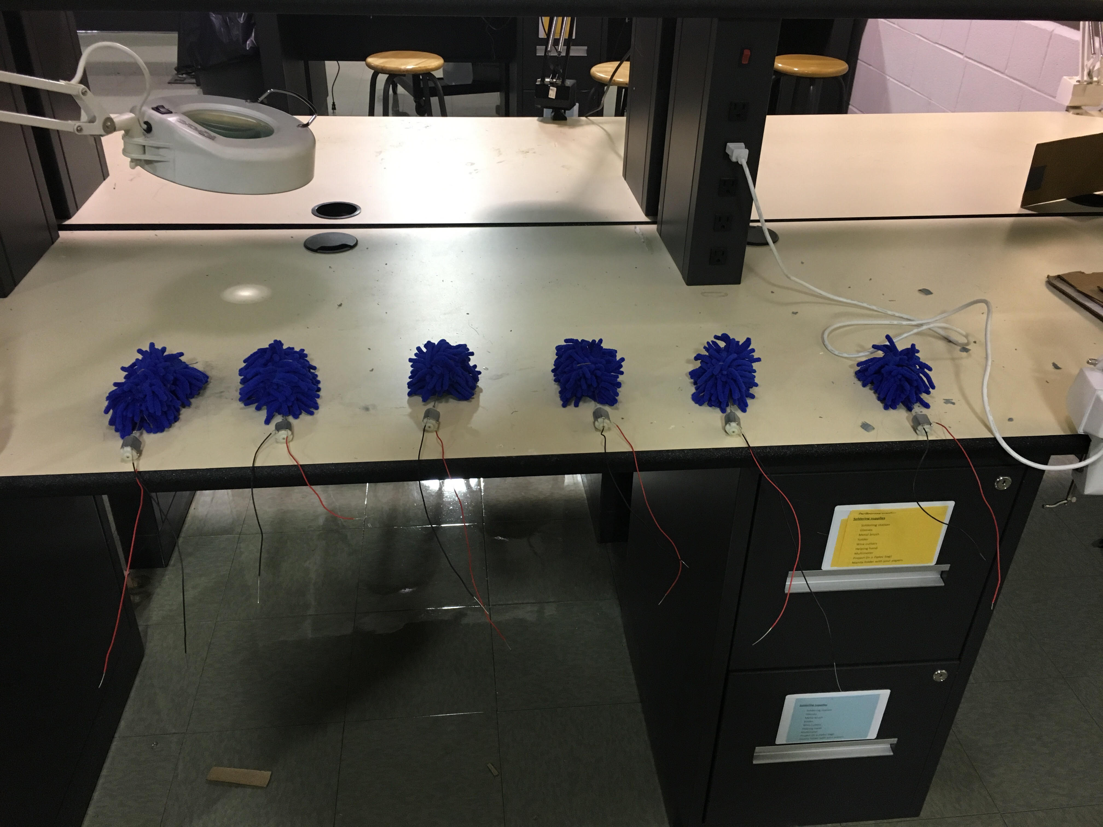
Constructing A prototype

Slide 10
Market Pitch

Slide 11
Final Picture

Slide 12
Thank You!
Emily Tunis: President and Chief Operating Officer Hardwire LLC
UMES Electrical Engineering Department
Mr. Cropper: WTHS Culinary Teacher and Fager’s Manager

